Slide 1
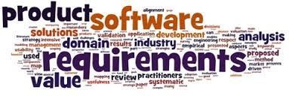
Software Requirement Engineering
Requirements from the customer’s perspective
Week # 4

Slide 2



• The essential software requirement
• Requirements from the customer’s perspective
• Good practices for requirements engineering
• The business analyst

Slide 3
Content
• Requirements from the customer’s perspective
• The Expectation Gap
The customer-development partnership
• Identifying decision makers
• Reaching agreement on requirements
• The requirements baseline
• Agreeing on requirements on agile projects

Slide 4


Slide 5

–The Stakeholders –

Slide 6
Stakeholder: A definition
• According to Wiegers & Beatty:
▫ “[A stakeholder is an]individual, group, or organization that is actively involved in a project, is affected by its process or outcome, or can influence its process or outcome.”

Slide 7
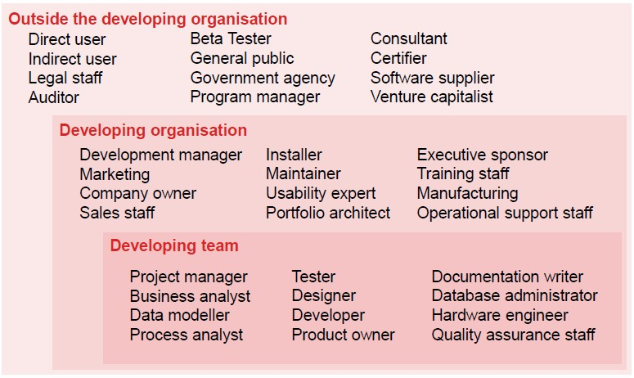
Examples potential stakeholders

Slide 8
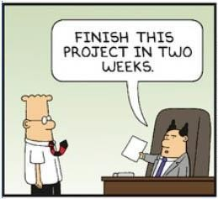
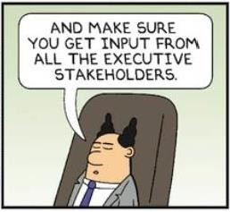
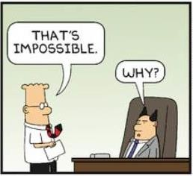
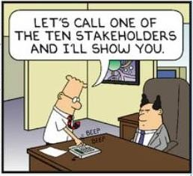
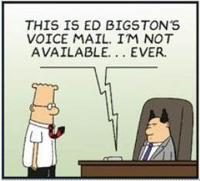
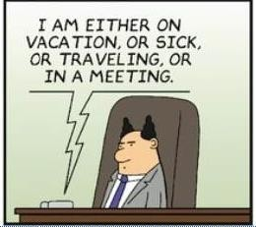
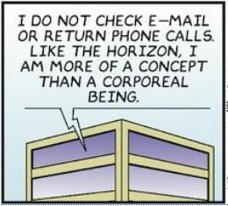
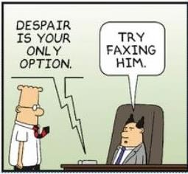
Busy Stakeholders…

Slide 9
The Customer: A definition
• According to Wiegers & Beatty:
▫ “[A customer is an]individual or organization that derives either direct or indirect benefit from a product. Software customers might request, pay for, select, specify, use, or receive the output generated by a software product.”

Slide 10
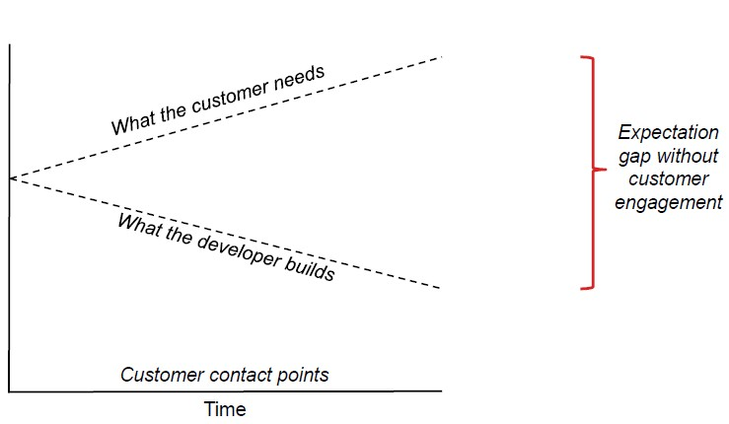
Expectation gap

Slide 11
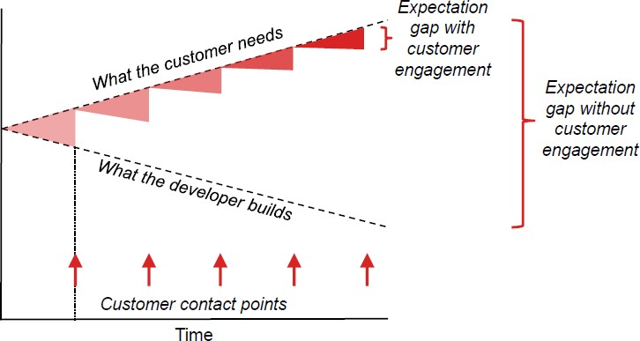
Expectation gap

Slide 13
The customer-development partnership
• An excellent software product results from a well-executed design based on excellent requirements.
• Excellent requirements result from effective collaboration between developers and customers (in particular, actual users)—a partnership.
• A collaborative effort can work only when all parties involved know what they need to be successful and when they understand and respect what their collaborators need to be successful

Slide 14
The customer-development partnership
• As project pressures rise, it’s easy to forget that all stakeholders share a common objective: to build a product that provides adequate business value and rewards to all stakeholders.
• The business analyst typically is the point person who has to forge this collaborative partnership.

Slide 15
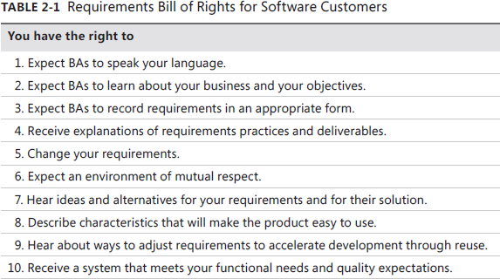
Requirements Bill of Rights for Software Customers

Slide 16
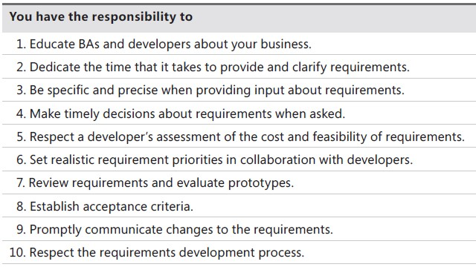
Requirements Bill of Responsibilities for Software Customers

Slide 18
Identifying decision makers
• The decision-making group needs to identify its decision leader and to select a decision rule, which describes how they will arrive at their decisions.
• A small group representing key areas—such as management, customers, business analysis, development, and marketing

Slide 19
Identifying decision makers (Cont..)
• According to Gottesdiener, 2001: the following decision rules are used by the decision makers group:
▫ The decision leader makes the choice, either with or without discussion with others.
▫ The group votes and the majority rules.
▫ The group votes, but the result must be unanimous to approve the decision.

Slide 20
Identifying decision makers (Cont..)
• According to Gottesdiener, 2001: the following decision rules are used by the decision makers group:
▫ The group discusses and negotiates to reach a consensus. Everyone can live with the decision and commits to supporting it.
▫ The decision leader delegates authority for making the decision to one individual.
▫ The group reaches a decision, but some individual has veto authority over that decision.

Slide 22
Reaching agreement on requirements
• Reaching agreement on the requirements for the product to be built, or for a specific portion of it, is at the core of the customer-developer partnership.
• Multiple parties are involved in this agreement:
▫ Customers agree that the requirements address their needs.
▫ Developers agree that they understand the requirements and that they are feasible.

Slide 23
Reaching agreement on requirements (Cont..)
• Multiple parties are involved in this agreement:
▫ Testers agree that the requirements are verifiable.
▫ Management agrees that the requirements will achieve their business objectives.

Slide 25
The requirements baseline
• A requirements baseline is a set of requirements that has been reviewed and agreed upon and serves as the basis for further development.
• A meaningful baseline process gives all the major stakeholders confidence in the following ways:
▫ Customer management or marketing is confident that the project scope won’t
explode out of control, because customers manage the scope change decisions.

Slide 26
The requirements baseline (Cont..)
• A meaningful baseline process gives all the major stakeholders confidence in the following ways:
▫ User representatives have confidence that the development team will work with them to deliver the right solution.
▫ Development management has confidence because the development team has a business partner who will keep the project focused on achieving its objectives and will work with development to balance schedule, cost, functionality, and quality.

Slide 27
The requirements baseline (Cont..)
• A meaningful baseline process gives all the confidence in the following ways:
major stakeholders
▫ Business analysts and project managers are confident that they can manage changes to the project in a way that will keep chaos to a minimum.
▫ Quality assurance and test teams can confidently develop their test scripts and be fully prepared for their project activities.

Slide 29
Agreeing on requirements on agile projects
• Agile projects do not include a formal sign-off action.
• Agile projects generally maintain requirements in the form of user stories in a product backlog.
• The product owner and the team reach agreement on what stories will be developed in the next iteration in a planning session.

Slide 30
Agreeing on requirements on agile projects
• The set of stories is chosen based on their priority and the team’s velocity (productivity).
• Requested changes that come in are considered for future iterations.
• In agile projects the full set of functionality is identified over time, although the vision and other business requirements do need to be established at the outset.

Slide 31
Summary
• Requirements from the customer’s perspective
• The customer-development partnership
• Identifying decision makers
• Reaching agreement on requirements
• The requirements baseline
• Agreeing on requirements on agile projects

